Slide 1

Behavioural Science and Consumer Protection: Scam Disruption
White Collar Crime Symposium
May 27, 2026
INTERNAL ONLY

Slide 2
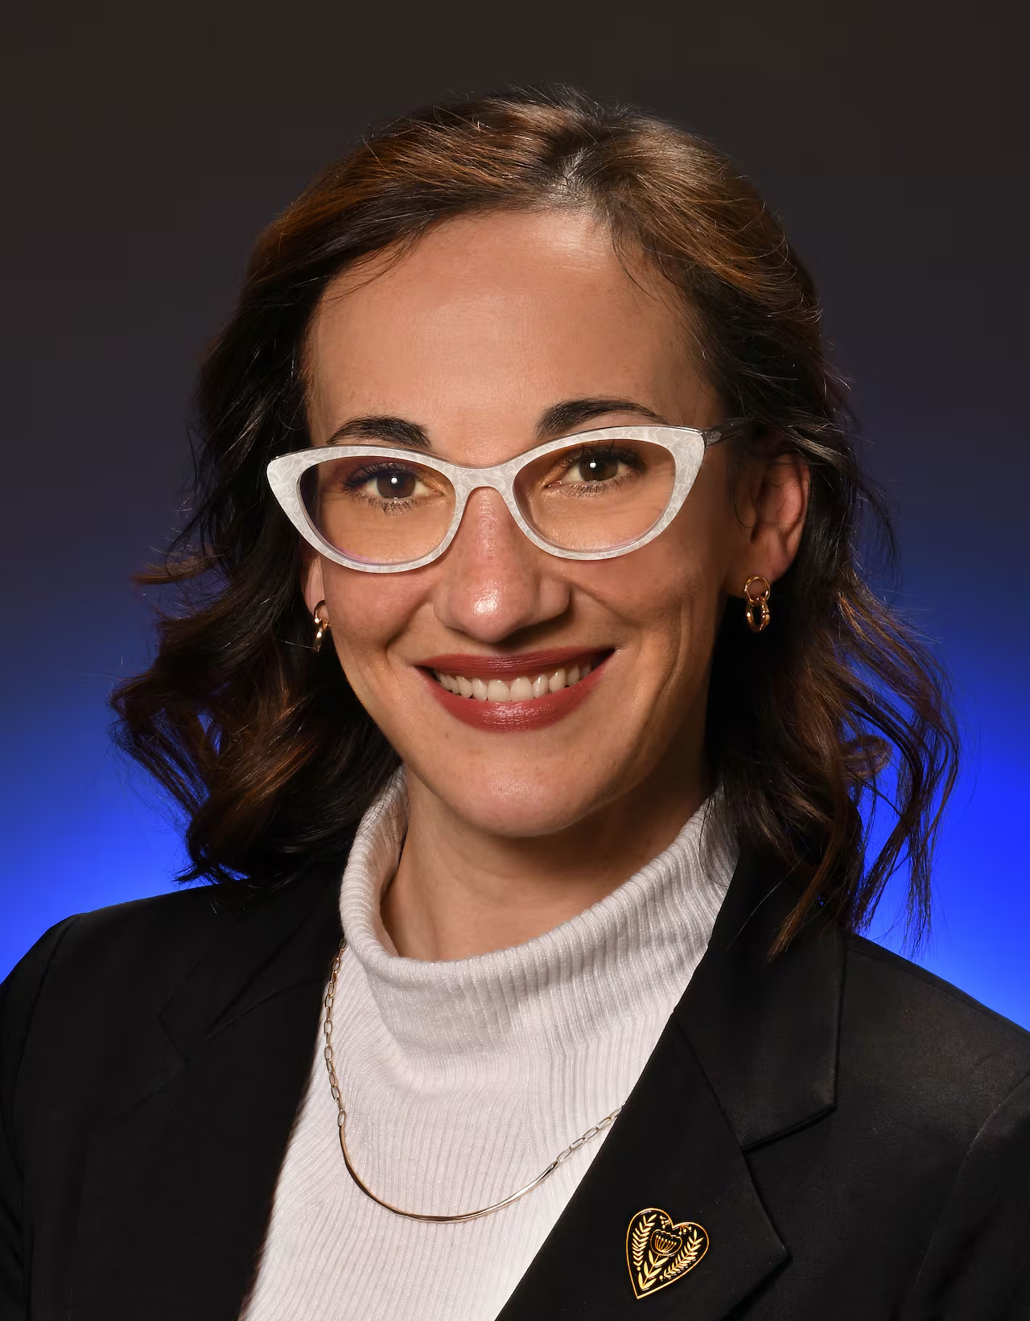

Introductions
Marissa Sollows
Director of Communications and Public Affairs, FCNB
Sasha Tregebov
Managing Director,
BIT Americas

Slide 3
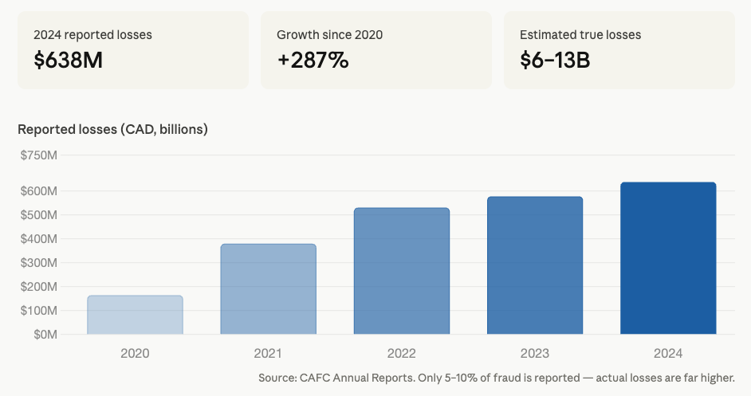
The Challenge
High-impact scams, limited evidence on what works in practice:
Scale and speed of harm
Behavioural vulnerability
Evidence and operational
gaps

Slide 4
Case: disrupting crypto investment scams on social media
Crypto Investment Scams
Fraudulent schemes that promise lucrative crypto projects, tokens, or platforms.
A major, representative category of scam - and one we could test
Social Media
Especially highly visual platforms like Instagram and TikTok.
A primary channel for both fraud and consumer engagement / education

Slide 5





We selected four strategies for testing
Prioritized & Tested
Inoculation
Behavioural
consistency
Active
participation
Mindfulness

Slide 6

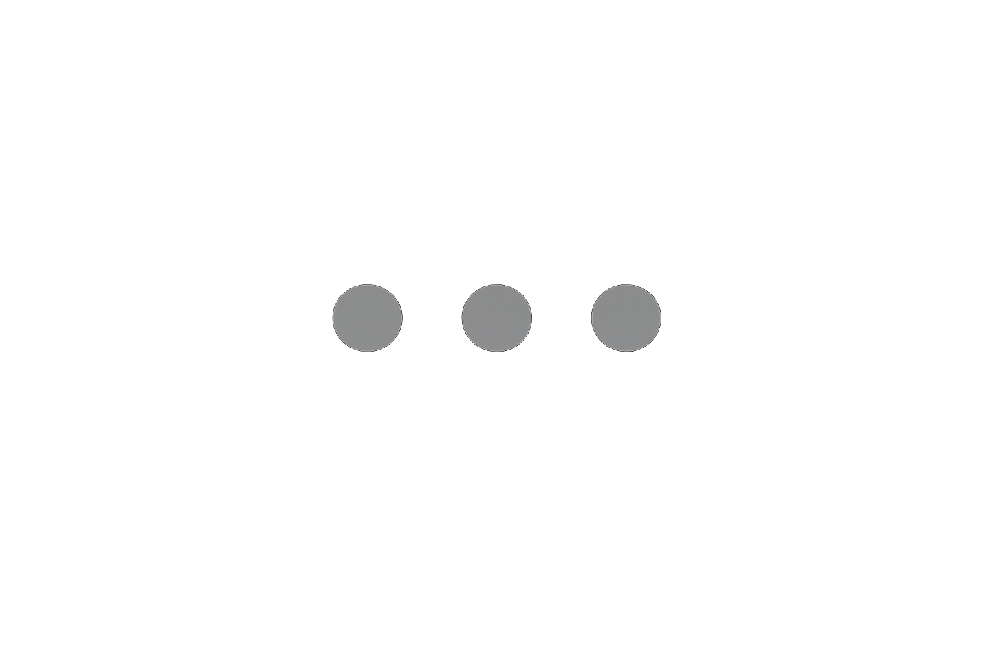

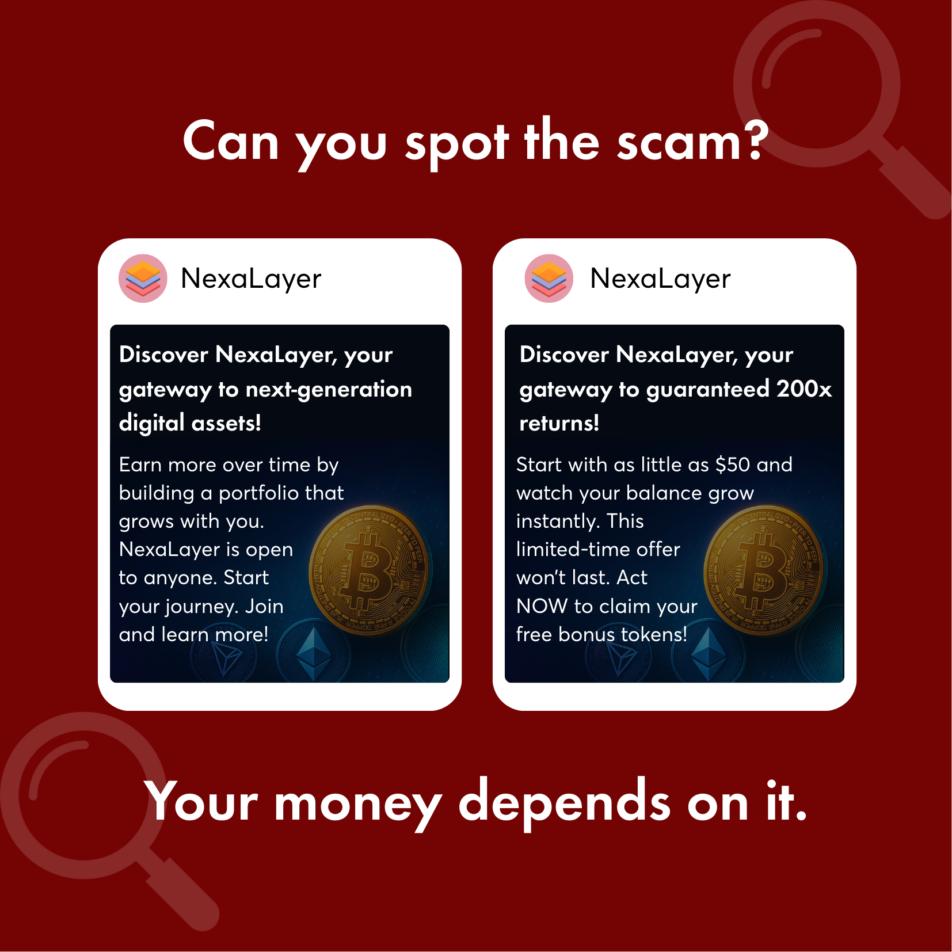
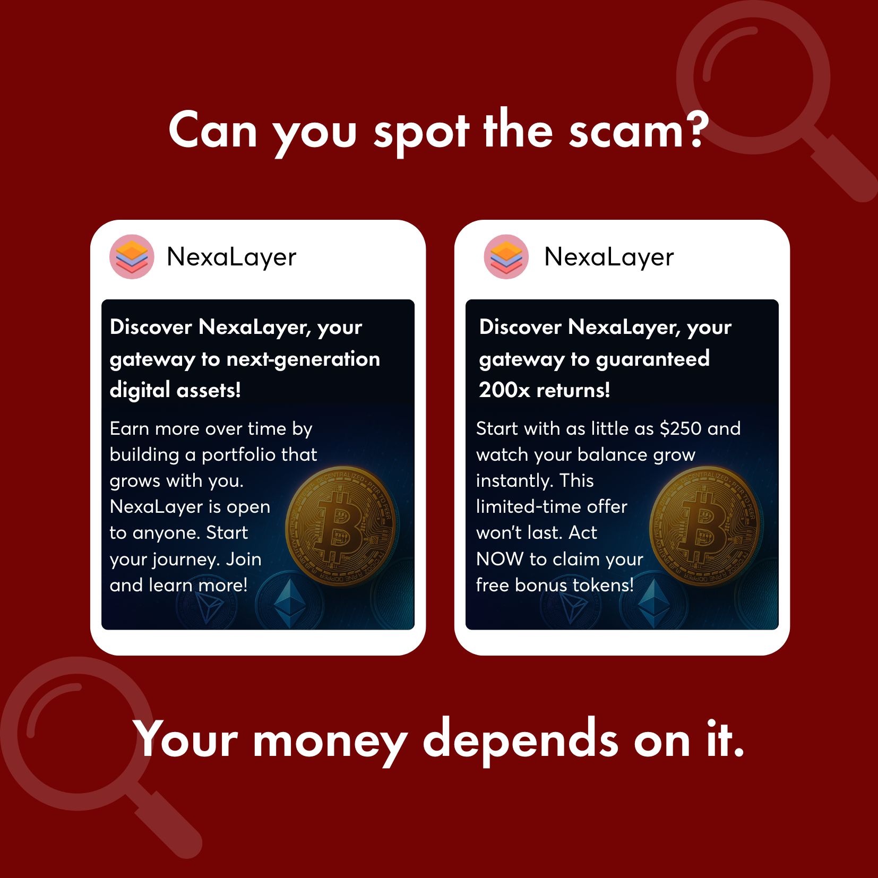
Invest FedReg
Yesterday
Get scam smart: Look for unrealistic promises, pressure to act fast, and guaranteed returns.
Active participation:
Can you spot the scam?

Slide 7
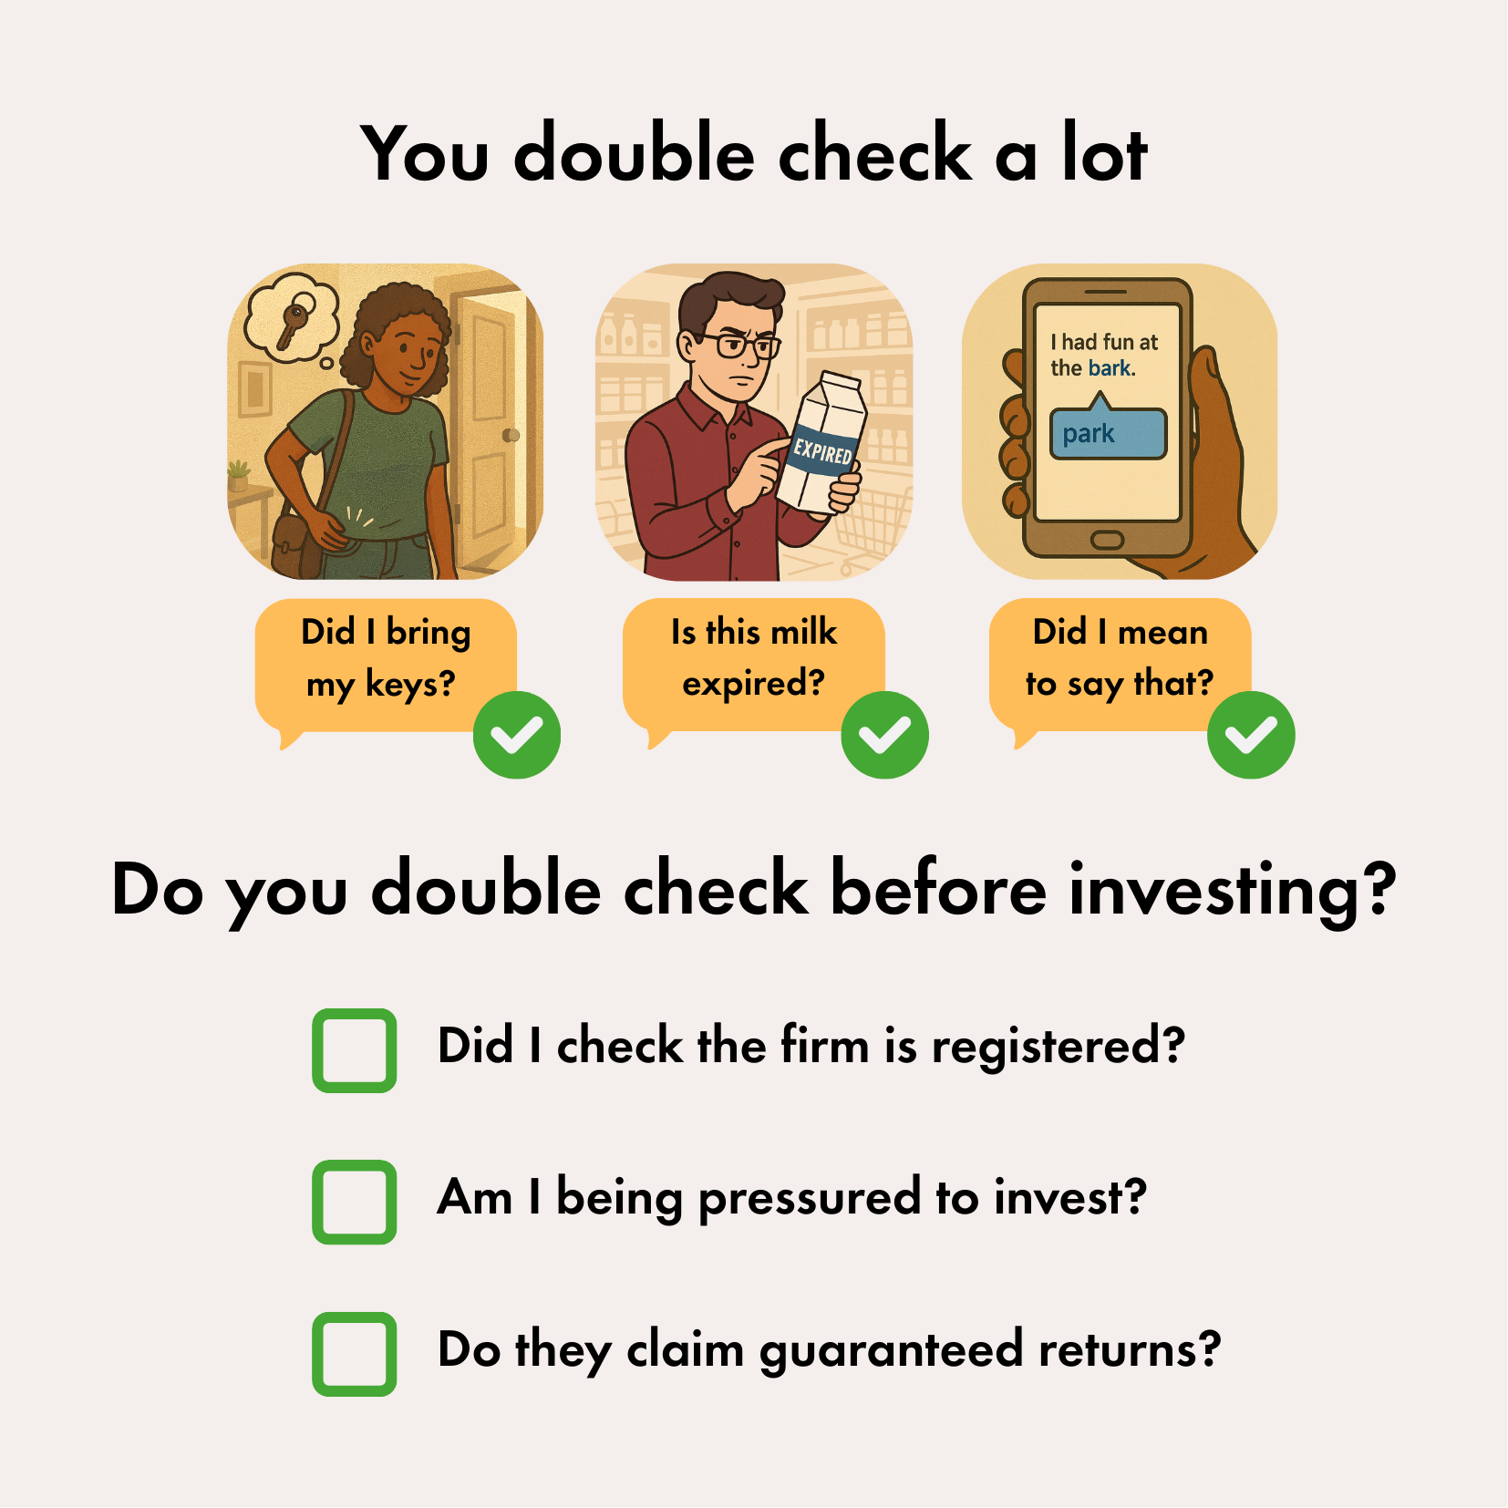
Invest FedReg
Yesterday
Smart investing starts with double-checking.
Behavioural consistency:
You double check a lot!

Slide 8
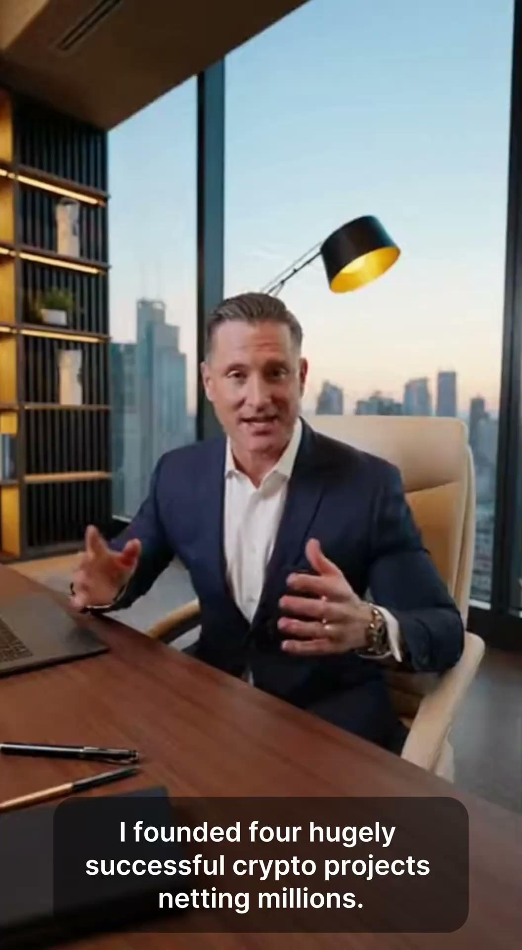
Invest FedReg
Yesterday
Inoculation (Video):
Is it a scam?

Slide 9
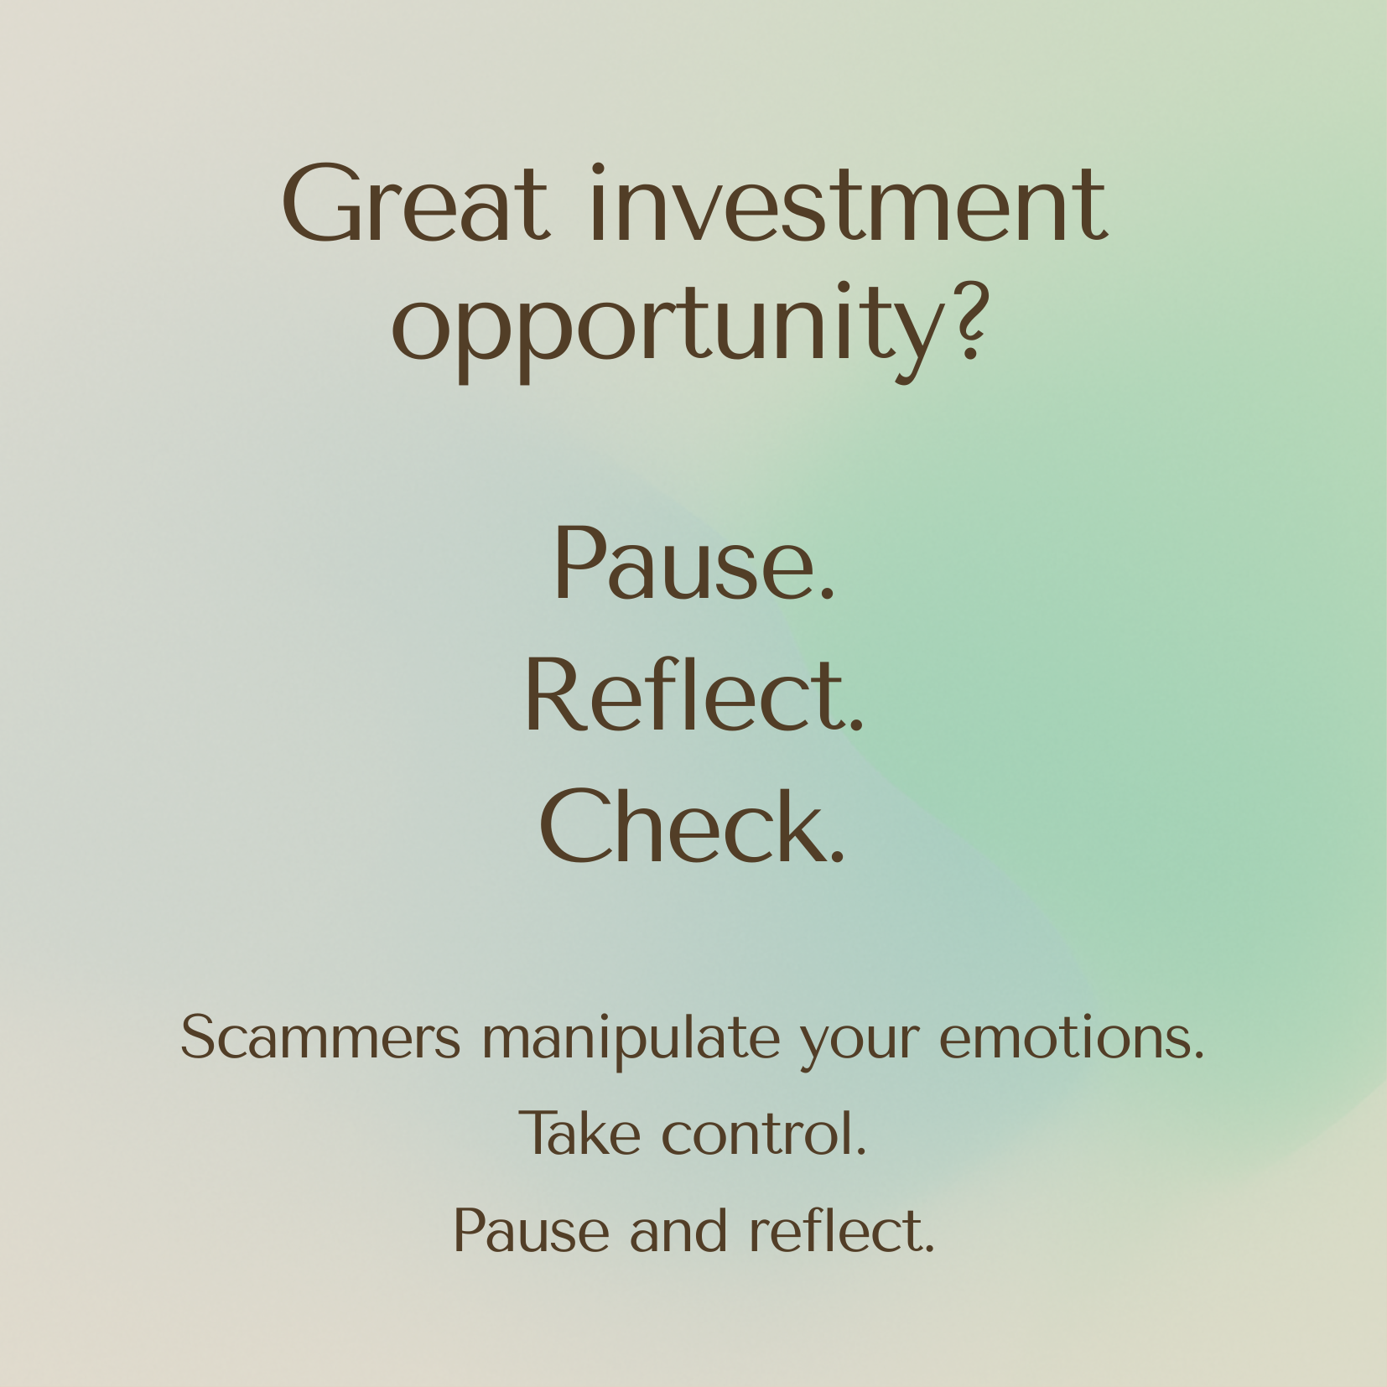
Invest FedReg
Yesterday
Mindfulness:
Pause. Reflect. Check.

Slide 10

We had ambitious testing goals!
How does each post influence consumer behaviour?
Also,
Did they engage with the post?
Did they like it?
Did they learn from it? (I.e., could they better identify red flags and protective actions?)

Slide 11





We ran an online randomized controlled trial
Recruitment
Allocation
Intervention
Follow-up & analysis
Control
No communication
Social feed
12 Posts:
3 Scams,
3 “Legit,”
6 Unrelated
Treatments
Simulated
Investment Decision
Randomize
Inoculation
Consistency
Questionnaire
N = 2,500 Canadians
Active
Participation
Mindfulness

Slide 12
Spotlight: Simulated investment decision
Investment Opportunity | Amount invested
Market Signals Insider | $ [ ____ ]
Reliosa Research | $ [ ____ ]
WayPoint | $ [ ____ ]
Echelon Green | $ [ ____ ]
AtLast Exchange | $ [ ____ ]
CoreXchange | $ [ ____ ]
Total | $10,000

Slide 13
Make your bets! What worked best?
“Can you spot the scam”
uses active participation
“You double check a lot”
uses behavioural consistency
“Is it a scam?” Video
uses inoculation
Pause. Reflect. Check.
uses pause and reflection
A
B
C
D
Notes:
Poll:
https://app.sli.do/event/iFBqJypSjHM62WQLPXMt6X
Presentation link:
https://wall.sli.do/event/iFBqJypSjHM62WQLPXMt6X?section=08e45e84-c861-48ba-a9cd-8a253c262143&integration=shared-present-mode&utm_source=slidoadmin

Slide 14
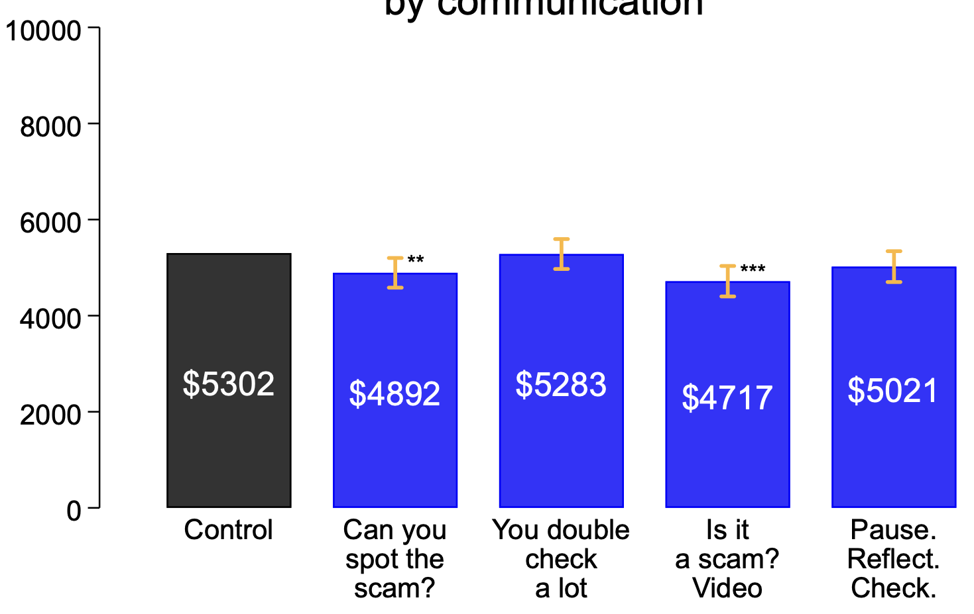
The inoculation video and quiz-style post moved the dial
11%
We believe these two posts worked primarily because they “disrupted” passive scrolling and prompted people to engage more critically.
8%
n = 2,500
*** p < .001, ** p < 0.0125
Primary analysis, controlling for recall, age, gender, and whether they are an investor

Slide 15
It wasn’t increased knowledge that improved outcomes
Correct red flags | % of participants that selected the correct red flag by communication group
 | Control | Can you spot the scam? | You double check a lot | Is it a scam? Video | Pause. Reflect. Check. | All Treatments
Returns are guaranteed (e.g., 1% profit daily) | 48% | 49% | 47% | 47% | 46% | 47%
Indicates a need to act quickly | 60% | 67% | 64% | 66% | 64% | 65%
Specifically noted in communication
Not specifically noted in communication

Slide 16
People preferred the less effective communications
Attitudes towards the post
Communication | Negative | Neutral | Positive
Can you spot the scam? | 21% | 30% | 49%
You double check a lot | 2% | 21% | 77%
Is it a scam? Video | 35% | 36% | 29%
Pause. Reflect. Check. | 5% | 25% | 69%
Did people have a less positive impression of the effective posts because they disrupted passive scrolling?
We cannot rely on self-reported preferences to guide our communications!

Slide 17
Engagement was limited - and important!
Overall engagement was limited, with only 31-52% correctly identifying the post they saw. The quiz and video had similar effects among those who actively engaged with them, but more people engaged with the video.
Outcome | Can you spot the scam? | You double check a lot | Is it a scam? Video | Pause. Reflect. Check.
Participants that correctly remembered the communication they saw (engaged) | 39% | 44% | 52% | 31%
Allocation to fraudulent opportunities among those that remembered | $4,576 (-14%) | $5,035 (-5%) | $4,512 (-15%) | $5,089 (-4%)
Allocation to fraudulent opportunities among those that did not remember | $5,273 (-1%) | $5,655 (7%) | $5,072 (-4%) | $5,210 (-2%)

Slide 18
Recommendations and Next Steps
Scale What Worked
Take the effective posts, adapt for your context, and gather more data!
Keep Testing
Use innovative approaches like this trial to generate behavioural / impact data - not just self-reported preferences or “clicks”!

Slide 19
Recommendations and Next Steps
Expect Tradeoffs
The tradeoff between what people like and what changes their behaviour may not be solvable.
More Research
Deep dive into the sentiment-effectiveness gap.
Transferability of findings across scam types and media.

Slide 20
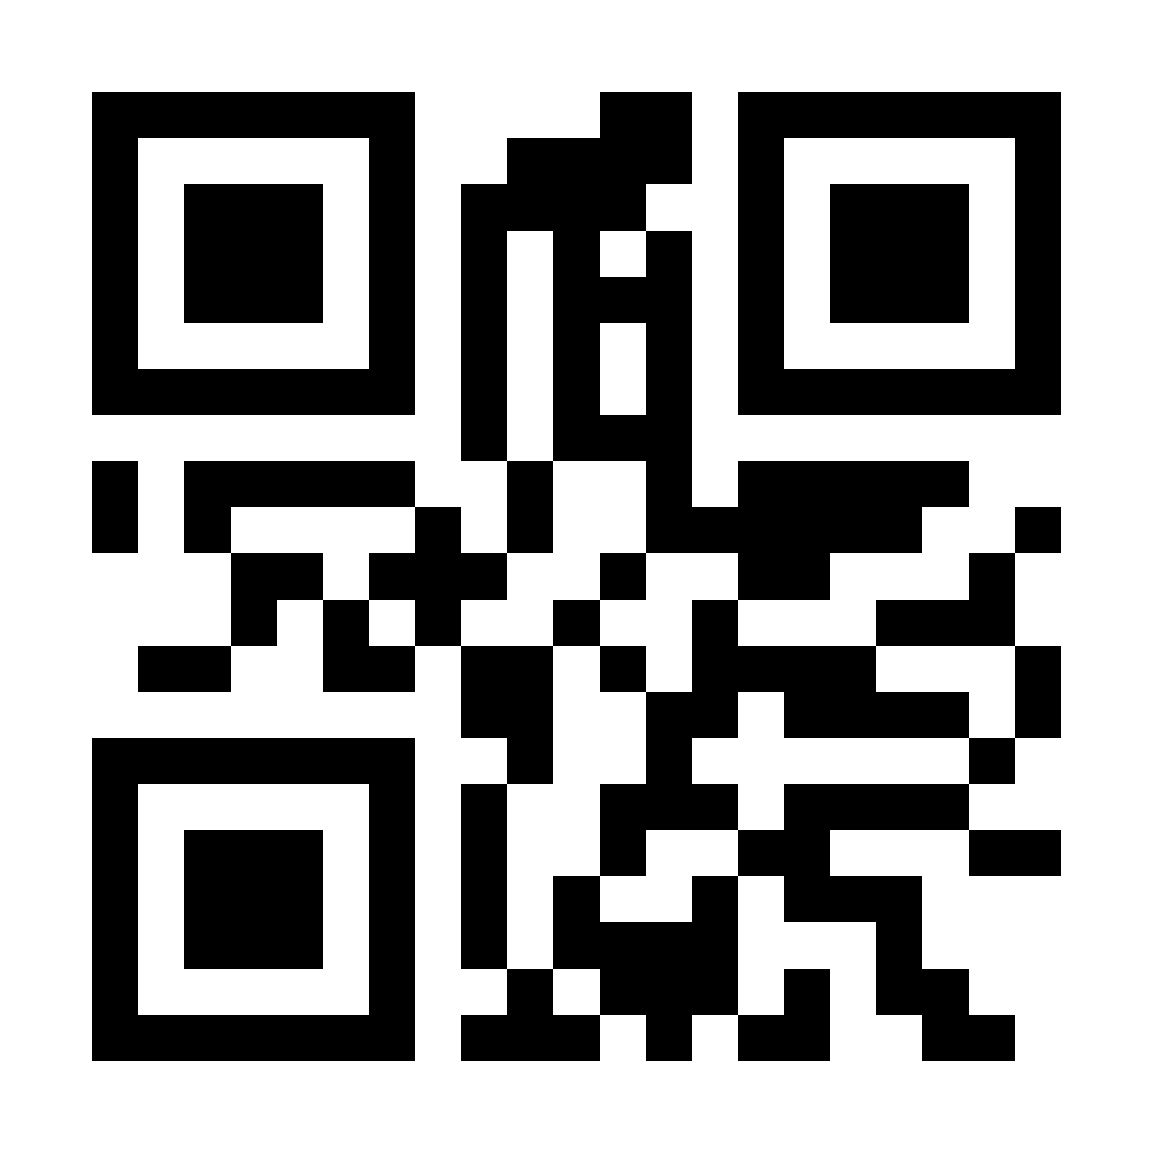
Questions and Reflections
Get in touch!
Marissa Sollows
marissa.sollows@fcnb.ca
Sasha Tregebov
sasha.tregebov@bi.team
Should you have further questions!

