Slide 1

Disrupting
Online Investment Fraud: the securities regulators’ perspective
Susan Powell, Director, Enforcement
Financial and Consumers Services Commission
Lori Chambers, Deputy Director, Enforcement
British Columbia Securities Commission

Slide 2

Canadian Securities Administrators (CSA)
Enforcement Committee
umbrella organization of all 13 provincial securities regulators
coordinates multi-jurisdictional investigations
share tools and techniques
provides a forum for jurisdictions to share enforcement intelligence
responsible for identifying priority initiatives on an annual basis
promote IT solutions for enforcement and information sharing

Slide 3

Types of Online Investment Scams
Pig
Butchering
AI-enabled Impersonation Scams
Boiler Room Scams
Pump and Dumps
Recovery Scams
Pump and Dumps
Spoofing
Affinity Frauds
Exempt Security Scams
Ponzi
Scams
Romance Frauds
Financial Authorities
Law Enforcement
Private
Sector
International Organizations
Regulators
Government

Slide 4
Potential Solutions
Public Awareness and Education
Disruption
National Collaboration
International Collaboration
Disciplining Unregistered CTPs

Slide 5

Disruption through prevention: warning the public

Slide 6
Advertisement example:
BC Securities Commission
We’re Not All F**ked

Slide 7
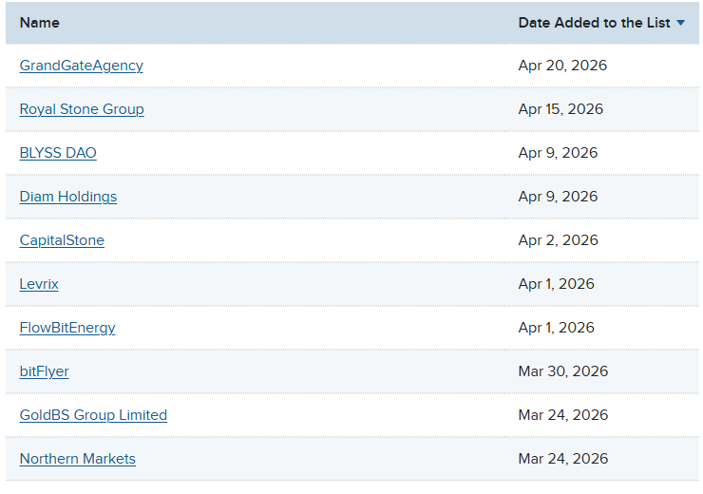
Public Investment Caution Lists

Slide 8

Disruption through takedowns

Slide 9

Malicious Website Removals
  started individually
  enlisted third party
  over 8,735 websites taken down in 9 months
  majority taken down within 24 hours

Slide 10
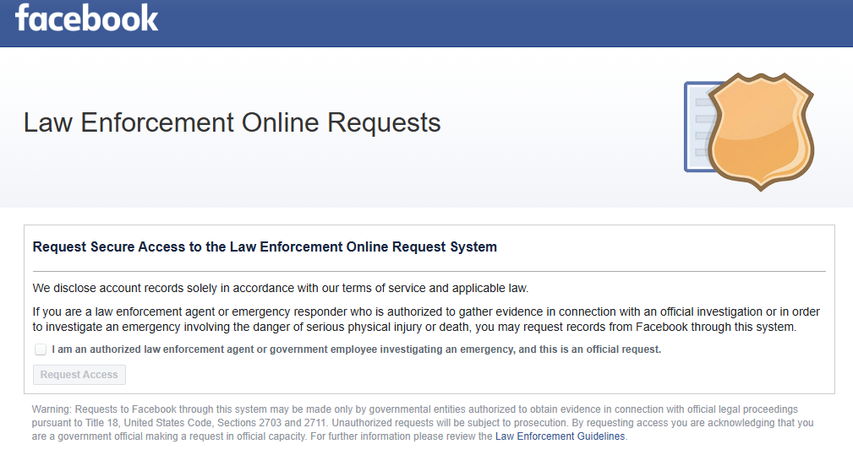

META Removal Requests

Slide 11

Disruption through operations

Slide 12
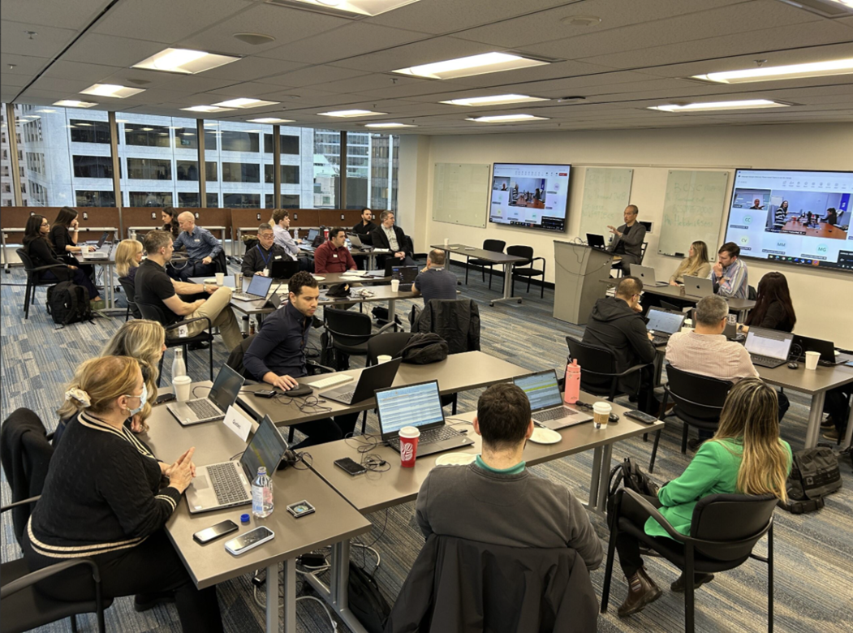
Operation Avalanche
BC Securities Commission
Alberta Securities Commission
Ontario Securities Commission
L'Autorité des marchés financiers
RCMP
Delta Police Department
Vancouver Police Department
U.S. Secret Service
Crypto trading platforms
Chainalysis

Slide 13
RCMP Federal Policing investigators and BCSC tackle overseas investment fraud by targeting “money mules”

Slide 14

Disruption through collaboration

Slide 15

Atlas
Atlantic
Maple Disruption
CASC
CB
Federal Government consultation

Slide 16

International Collaboration

Slide 17


